Slide 1
Bloodborne Pathogens in a Clinical Setting

Slide 2
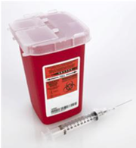
Bloodborne Pathogens in a Clinical Setting
Each of us can prevent disease caused by contact with pathogens found in blood and other potentially infectious materials (OPIM). Infection control measures, put into place by this facility, guide health care workers in this prevention. Every health care worker must be aware of these infection control measures and his or her role in order to protect himself or herself and others.
Designed for clinical staff, this course discusses the most common diseases caused by pathogens found in blood and OPIM and explains how infection control measures put into place in this facility protect health care workers from these diseases.

Slide 3

Responsibility: A Reminder
Knowledge of infection control measures is very important. This knowledge will protect you only if you are committed to applying this knowledge in your day-to-day work. It is the responsibility of each team member to understand his or her risk of exposure to infectious materials and how to protect himself or herself.

Slide 4
Review of Key Terms
CDC: Centers for Disease Control and Prevention. Recognized as the lead federal agency for protecting the health and safety of people at home and abroad, providing credible information to enhance health decisions, and promoting health through strong partnerships.
Centers for Medicare & Medicaid Services (CMS): The Centers for Medicare & Medicaid Services (CMS) is an agency within the U.S. Department of Health & Human Services responsible for administration of several key federal health care programs. In addition to Medicare (the federal health insurance program for seniors, people with end stage renal disease, and those with disabilities) and Medicaid (the federal needs-based program), CMS oversees the Children's Health Insurance Program (CHIP), the Health Insurance Portability and Accountability Act (HIPAA) and the Clinical Laboratory Improvement Amendments (CLIA), among other services
health care-associated infections: Infections that patients acquire during the course of receiving treatment for other conditions within a health care setting.
​immune system: The body's very complex system (made of many organs and cells) that defends the body against infection, disease, and foreign substances.
other potentially infectious materials (OPIM): Materials that carry pathogens that cause serious diseases. These materials include human body fluids (e.g., semen, vaginal secretions, cerebrospinal fluid, synovial fluid, any body fluid that is visibly contaminated with blood), unfixed tissue or organs, and HIV/HBV/HCV-containing cell or tissue cultures.
sharps: Any object that can cut, puncture, or go through the skin. For instance, needles, scalpels, broken glass, knives, and blades are all sharps.
transmissible infections: Infections caused by pathogens that are easily spread to and from health care workers

Slide 5
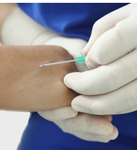
Pathogens Found in Blood and OPIM and Diseases of Major Concern
Contact with blood or body fluids may subject health care workers to viruses. Diseases caused by the following three pathogens are of major concern to health workers:
Human immunodeficiency virus (HIV)
Hepatitis B virus (HBV)
Hepatitis C virus (HCV)
There are three diseases caused by these viruses:
Acquired immunodeficiency syndrome (AIDS)
Hepatitis B
Hepatitis C

Slide 6

Hepatitis A
Hepatitis A has not been included as a disease of primary concern for health care workers because it is not spread in the same manner as hepatitis B and hepatitis C. Hepatitis A is caused by the hepatitis A virus (HAV) and spread by the fecal-oral route, such as through fecal contamination of food or water. Hepatitis A is not a bloodborne disease.

Slide 7
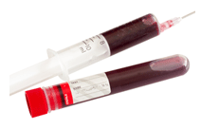
Description and Testing of HIV and AIDS
HIV attacks the immune system. It is spread through sexual contact or contact with blood or OPIM. HIV attacks white blood cells. Over time, the infected person's body has fewer white blood cells, and the lack of white blood cells decreases immune response to other disease-causing pathogens. It takes years for this loss of white blood cells to occur. During this time, an infected person may not even know he or she is infected, but he or she can spread the pathogen to others. In most cases, being HIV positive leads to AIDS.
There is no cure for AIDS, but there is treatment to control the symptoms.
A person can be tested to see if he or she has been infected by HIV. Urine, oral fluids, and blood may also be tested. These tests seek to determine whether the body has had an immune response to HIV. For this reason, the tests will not work right away. The average time it takes to detect an immune response is 20 days, and although most people will show a response in 3 months, there have been rare cases in which an immune response did not show until 6 to 12 months after infection.

Slide 8
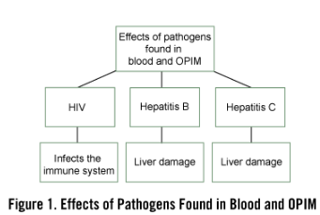
Description and Testing of HBV and Hepatitis B
Of the diseases spread by contact with blood or body fluids, hepatitis B is very common.
HBV is a virus that attacks the liver. Over time, this virus may cause scarring of the liver. The signs and symptoms of hepatitis B usually occur 12 weeks after exposure and include:
Enlarged liver
Yellow tinge to the skin or the whites of the eyes (jaundice)
Loss of appetite
Nausea
Abdominal pain
Dark urine
Extreme fatigue
Joint pain
Many people infected with this virus do not have any symptoms. However, even though they may not have symptoms, they may still spread the disease to others.
Figure 1 shows the effects of pathogens found in blood and OPIM.
A person can be tested to see if he or she is infected with HBV through a blood test. As with the test for HIV, one must wait to be tested. The average time it takes to detect an immune response is 4 weeks with HBV.

Slide 9
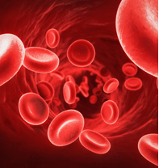
Description and Testing of HCV and Hepatitis C
Like HBV, HCV attacks the liver. Eighty percent of hepatitis C patients appear to have no symptoms. However, even though there are no symptoms, the virus may infect others. The virus may remain in the body for a long time before symptoms such as fatigue, loss of appetite, and abdominal pain begin.
HCV causes chronic disease in about 75%-85% of the people who contract it. Out of every 100 persons who are infected with HCV, 55 to 85 may develop long-term infection, and 70 may develop chronic liver disease. The number of reported cases of acute hepatitis C declined rapidly until 2003 and remained steady until 2010. From 2012 to 2013, there was a 20% increase in reported hepatitis C cases.​
In 2019, a total of 4,133 cases of acute hepatitis C were reported to the CDC from 42 states. The overall incidence rate for 2019 was 1.3 cases per every 100,000 population. Actual acute cases are estimated to be 13.9 times the number of reported cases in any year. After adjusting for under-ascertainment and underreporting, an estimated 57,500 acute hepatitis C cases occurred in 2019.
There are several blood tests for HCV. The time at which a person is tested following exposure to HCV varies, based on the test that is ordered by his or her health care provider.

Slide 10
HIV Is Not Contracted
HIV is not spread by:
Contact with telephones, doorknobs, or toilet seats
Mosquito bites
Eating food prepared by an individual with HIV
Shaking hands, hugging, being coughed on, or being sneezed on
Donating blood
The risk of contracting HIV from a blood transfusion is extremely low. The blood supply is tested for HIV.

Slide 11
How is HIV Spread?
HIV spreads through contact with the blood or OPIM of a person who has the virus in his or her body.
HIV can spread through exposure to infected blood in the workplace, but this is not a common cause of HIV infection.
The most common ways HIV spreads include:
Sexual contact: The semen and vaginal fluids of persons infected with HIV have the potential to spread HIV. Both heterosexual and homosexual sexual contact may result in the spread of HIV.
Intravenous (IV) drug use: When IV drug users share needles, they exchange body fluids, and this exchange puts IV drug users at high risk.
Mother to baby: While pregnant, a mother who is infected may infect her baby. Proper health care while the mother is pregnant can decrease this risk. A mother may also infect her baby if she breastfeeds.

Slide 12
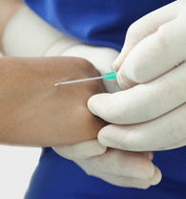
Risk of Infection for HIV
For health care workers, the risk of infection from contact with HIV on the job is extremely low. In fact, as of 2019, the Centers for Disease Control and Prevention (CDC) has documented only 58 cases of infection due to work-related exposure. According to the CDC, the chances of becoming HIV positive when exposed to HIV through a needlestick are less than 1% (2019). The risk is less for blood splashes into mucous membranes or on broken or scraped skin. There is no vaccine to stop the spread of HIV.

Slide 13
How Is Hepatitis B Spread?
Like HIV, hepatitis B spreads through contact with the blood or OPIM of a person who has HBV in his or her body.
The most common ways HBV spreads include:
Sexual contact: The semen and vaginal fluids of persons infected with HBV have the potential to spread HBV. Both heterosexual and homosexual sexual contact may result in the spread of HBV.
IV drug use: When IV drug users share needles, they exchange body fluids, and this exchange puts IV drug users at risk of coming into contact with HBV.
Mother to baby: While pregnant, a mother who is infected may infect her baby. During prenatal screening, the mother is checked for HBV infection. If a mother is infected with HBV, treatment may begin on the baby at birth.

Slide 14
Risk of Disease with HBV
Hepatitis B infection is a serious risk for health care workers. However, this risk can be decreased with the hepatitis B vaccine available to all health care workers at risk of coming into contact with this virus.
If you are exposed to HBV through a needlestick injury, the risk of infection is at least 30% if you have not received the hepatitis B vaccine. The risk is less for blood splashes into mucous membranes or on broken or abraded skin. Your risk drops to almost zero if you have had a successful series of vaccinations.
Of the people who show symptoms of hepatitis B, most have a full recovery. Less than 5% of otherwise healthy persons who are infected as adults will develop chronic hepatitis. People with chronic infections are at a higher risk for cirrhosis of the liver and liver cancer.

Slide 15
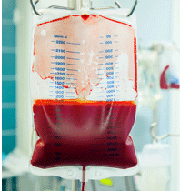
How Is Hepatitis C Spread?
Hepatitis C may be spread in a variety of ways:
The reuse or inadequate sterilization of medical equipment, especially syringes and needles in health care settings.
The transfusion of unscreened blood and blood products.
HCV may be contracted through sexual intercourse; however, the CDC reports that this does not happen often.
HCV may also be spread from mother to infant during birth.
The CDC reports that illegal injected drug use is the most common way HCV is transmitted.
Exposure to blood or OPIM puts health care workers at risk of hepatitis C. Unlike HBV, there is no vaccine to prevent this disease.

Slide 16
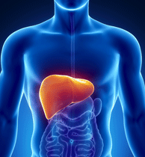
Risk of Disease with HCV
The risk of contracting disease from contact with HCV is not great. The CDC reports that of every 100 health care workers exposed to HCV through a needlestick, about 1 will become infected with HCV.
HCV causes chronic disease in about 55% to 85% of the people who contract it:
HCV is a major cause of cirrhosis of the liver and liver cancer.
Although there is no vaccine for hepatitis C, some patients are now being treated with new medication that can cure hepatitis C and offer shorter length of treatment and increased effectiveness.
Treatment usually leads to long-term improvement.
Complications of hepatitis—both hepatitis B and hepatitis C—account for the majority of liver transplants in the United States.

Slide 17
Review of Key Terms
Engineering Controls: measures that isolate or remove a hazard from the workplace (e.g., sharps disposal containers).
OSHA: Established under the Occupational Safety and Health Act of 1970, the Occupational Safety and Health Administration functions within the U.S. Department of Labor to set and enforce workplace safety and health standards
Personal Protective Equipment (PPE): Special clothing and equipment meant to protect against contact with bloodborne pathogens and other potentially infectious materials (OPIM).
Regulated waste: Contaminated items that could release blood or other potentially infectious material (OPIM) when a person handles them. Regulated waste also refers to contaminated sharps and pathological wastes (such as human tissues) or microbiological wastes (such as cultures and culture dishes) that contain blood or OPIM
Standard Precautions: Expand the concept of universal precautions to include other communicable diseases besides bloodborne pathogens. Standard precautions assume that certain areas of the body are colonized with disease-causing microorganisms that, if transmitted to others, could cause disease. These areas include mucous membranes, moist areas of the body, broken skin, anything wet coming from the body, and any medical devices that drain fluids from the body. Standard precautions do not protect against airborne diseases.
Universal Precautions: An approach used in infection control. Universal precautions treat all blood and other potentially infectious material as if they are known to be infected with bloodborne diseases.
Work practice controls: Practices to isolate or decrease the risk of exposure to infection in the workplace. Work practice controls include procedures used with standard and transmission-based precautions, hand hygiene, safe disposal of contaminated materials, and housekeeping practices.

Slide 18
Exposure Control Plan
OSHA requires employers in the health care field to develop an exposure control plan. This plan provides protection for all health care workers who might be exposed to pathogens found in blood and OPIM.
The plan is updated each year to include:
Changes in technology that reduce or eliminate exposure
Documentation that safer medical devices are adopted, if available
When this plan is updated, input is obtained from health care workers, including nonmanagerial workers providing direct patient care who are at risk of coming into contact with contaminated sharps.

Slide 19

Contents of the Exposure Control Plan
The exposure control plan must include an employee exposure determination, which lists:
Health care worker classifications that have exposure to blood or OPIM
Tasks or groups of related tasks that may result in exposure to blood or OPIM
This information is available to all health care workers.
The exposure control plan must also contain information regarding how this facility will:
Implement standard precautions
Provide the hepatitis B vaccination to health care workers at no cost to the employee
Conduct postexposure evaluation and follow-up
Communicate hazards to employees
Maintain records of all of the above issues
Lastly, this plan must include a procedure for evaluating the circumstances occurring during an exposure to blood or OPIM.

Slide 20
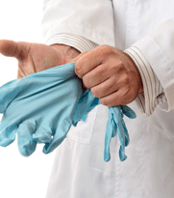
Implementation of Standard Precautions
Another way this facility protects workers and others from the spread of disease through contact with blood or OPIM is by using standard precautions. These precautions help workers avoid contact with blood and OPIM that may carry pathogens that cause disease. Standard precautions are used by all health care workers with all patients.
Universal precautions prevent the spread of bloodborne pathogens in blood and OPIM. Standard precautions expand the concept of universal precautions to include diseases that are spread from person to person by means other than bloodborne pathogens. The intent of standard precautions is to protect the health care worker and patients from pathogens that cause disease.

Slide 21
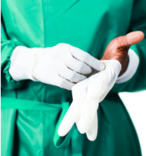
Standard Precautions: Protecting Yourself and Others
If health care workers are at risk of coming into contact with blood, body fluid, secretions, excretions (except sweat), nonintact skin, or mucous membranes, they should follow standard precautions and wear personal protective equipment (PPE).
PPE includes:
Gloves
Masks
Eye protection
Face shields to protect workers' mucous membranes
Gowns to protect workers' skin and clothing from becoming soiled

Slide 22

Employee Protection Measures
OSHA also requires facilities to provide employee protection measures that include:
Training and access to proper PPE to ensure compliance with standard precautions
Engineering and work controls that decrease or eliminate health care workers' exposure to hazards
Adequate signage and labeling of hazards
Medical surveillance of diseases that can be spread from person to person

Slide 23
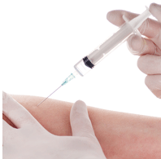
Hepatitis B Vaccine
The hepatitis B vaccine is offered at no charge to protect health care workers. You cannot contract hepatitis B from the vaccine. There will be three injections. The CDC recommends that the second and third injections be administered 1 and 6 months after the first injection.
You will be offered the hepatitis B vaccine series upon beginning work in an area of the facility in which you risk coming into contact with the hepatitis B virus (HBV). You may elect not to take this vaccine. If you change your mind and want to have the vaccine later, you may access it at any time.

Slide 24
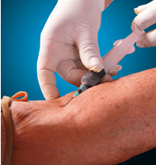
Medical Follow-Up and Evaluation
This facility has a postexposure plan in place for exposure to potentially infectious materials, including hepatitis B. If you come in contact with blood or OPIM, it is important that you report this exposure. The postexposure evaluation consists of four steps:
Testing the patient, who is the source, immediately (you cannot restrain the patient to keep him or her from leaving the facility)
Offering the exposed health care worker baseline testing
Offering the exposed health care worker treatment as needed
Offering the exposed health care worker counseling
​The postexposure laboratory algorithm has been updated and states that the exposed health care provider should be tested for antibodies to HCV four to six months after exposure.

Slide 25

Records of Exposure to Harmful Substances
To protect workers, OSHA requires that employers in the health care industry establish and maintain a confidential record for each employee with occupational exposure to a harmful substance. The exposure and results of the follow-up are confidential and should be kept in this record.
The exposed person is notified of diseases that the source patient might have had; the patient's identity is protected.

Slide 26
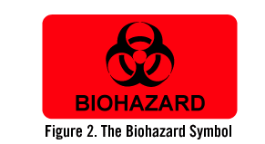
Communication of Hazards to Health Care Workers
As part of its worker protection responsibility, this facility must clearly communicate hazards to health care workers. For instance, regulated wastes must be bagged in leakproof plastic bags that feature the biohazard symbol. This special labeling will prevent the wastes from coming into contact with patients, workers, and visitors.
The biohazard symbol is a universal symbol placed on any container or area that may contain regulated waste. Biohazard signs are always red or orange and include the biohazard symbol.
Figure 2 shows the biohazard symbol
Used sharps are to be placed in puncture-resistant containers.

Slide 27
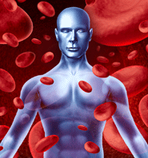
Circumstances during Exposure to Blood or OPIM
OSHA requires that exposure to blood or OPIM be reported. When a percutaneous exposure injury with a contaminated sharp occurs, the following information must be recorded in the manner required by OSHA:
Type and brand of device involved
Department or area where the injury occurred
Explanation of how the injury occurred
It is important to remember that the facility will protect the confidentiality of the injured employee in such records.

Slide 28
Protecting Yourself from Exposure
To minimize the risk of exposure to bloodborne pathogens, health care workers should know and follow the procedures established in their facility. These procedures include:
Using PPE
Maintaining proper hand hygiene
Cleaning up spills properly
Obeying engineering and work practice controls
Working correctly with medical devices
To minimize the risk of exposure to bloodborne pathogens, always use the required PPE. This specialized clothing and equipment provides protection against contact with blood or OPIM:
Wear a mask and eye protection when you could get splashed in the face by OPIM.
Use a CPR mask when performing CPR.
Wear a gown when your clothing could be soiled with blood or other bodily fluids.
Use gloves any time you have contact with blood or other body fluids (including when you handle dirty laundry).

Slide 29

Hand Hygiene
Protect yourself from the risk of exposure to bloodborne pathogens by practicing proper hand hygiene:
Use an approved alcohol-based hand rub or wash with soap and water.
Remember that wearing gloves does not replace hand hygiene.
Remove your gloves prior to leaving a patient room.
Perform hand hygiene after removing your gloves.
Follow proper hand washing procedures per Regulatory Agencies' Infection Control Standards: ​
Wash your hands with clean, running water (warm or cold), turn off the tap, and apply soap.​
Lather your hands by rubbing them together with the soap. Be sure to lather the back of your hands, between your fingers, and under your nails.
Scrub your hands for at least 20 seconds. Need a timer? Hum the "Happy Birthday" song from beginning to end twice.
Rinse your hands well under clean, running water.
Dry your hands using a clean towel or air dry them.

Slide 30
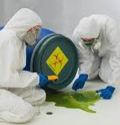
Cleanup of Spills
Minimize your risk of exposure to blood or body fluid spills. Take the following actions as quickly and effectively as possible:
Wear appropriate PPE.
Contain the spill.
Clean up and remove the spill.
Properly discard all cleaning materials.
Disinfect the area.

Slide 31
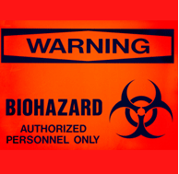
Engineering Controls and Work Practice Controls
In work areas where exposure to blood or OPIM is likely, you should:
Avoid applying cosmetics, lip balm, or contact lenses.
Avoid eating, drinking, or putting objects in your mouth.
Practice good housekeeping by observing established procedures and schedules for cleaning and disinfecting work areas.
Follow recommended practices for handling contaminated clothing and laundry.
Bag soiled linens (including isolation linens) in approved bags. Double-bag laundry if the outside of the first bag is visibly soiled.
Use proper containers for regulated waste.

Slide 32
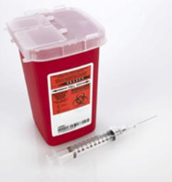
Disposing of Sharps
According to the Centers for Disease Control and Prevention (CDC), about 385,000 sharps injuries occur annually to hospital employees. Therefore, you should use safety devices to eliminate or reduce risk of exposure to bloodborne pathogens:
Sharps disposal containers
Self-sheathing needles
Sharps with engineered sharps injury protections, such as needleless systems
When you must use sharps, dispose of them in proper sharps containers. Never attempt to:
Bend or break needles
Remove needles from sharps containers
Recap needles after use

Slide 33
Medical Devices
Health care workers may be at risk of exposure to blood or OPIM when using medical devices. No single medical device is considered appropriate or effective for all circumstances. Choose medical devices that:
Do not jeopardize employee or patient safety
Make an exposure incident with a contaminated sharp less likely to occur

Slide 34
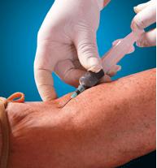
Medical Follow-Up and Evaluation
When you have contact with blood or OPIM, immediately clean the area:
Flush mucous membranes with water.
Flush eyes with clean water, saline, or sterile irrigants.
Wash needlestick or sharps injuries with soap and water.
Once you have cleaned the area:
Report the exposure incident to your supervisor immediately.
Document routes, circumstances, and the source of exposure.
Complete the evaluation and follow-up process.

Slide 35
Medical Follow-Up and Evaluation
OSHA requires each health care facility to develop and maintain an exposure control plan to deal with exposure of employees to blood and OPIM. Your facility's exposure control plan explains:
How to report an exposure to blood or OPIM
The kinds of medical follow-up that are available
OSHA requires that an employee be notified of the postexposure evaluation and the follow-up actions taken.

Slide 36

Be Informed and Follow Through
To minimize the risk of disease from exposure to blood or OPIM:
Know how you are protected by the exposure control plan.
Know the risks in your work area.
If procedures change, updated training will be provided. Attend these trainings.
Use standard precautions as appropriate.
Use appropriate PPE.
Consider the hepatitis B vaccination series when it is offered.
Properly dispose of regulated waste.
Contact your supervisor immediately if you are exposed to blood or OPIM.
For more information about bloodborne pathogens, contact your supervisor.

Slide 37
Be Assertive
If you find yourself in a setting in which you are not sure how to protect yourself, or if you have questions about how to use protective equipment, please talk to your supervisor. We are all working toward a common goal of keeping the work environment as safe as possible. Sharing your concerns may help your facility better understand the learning needs of all health care workers.
Give feedback to your supervisor about how to improve engineering controls and work practice controls.

Slide 38
Summary
Prevention of diseases caused by pathogens found in blood and OPIM can occur only when the facility and health care workers work together as a team. To decrease the spread of diseases caused by pathogens found in blood and OPIM, it is important that you know about these disease processes, how these diseases spread, what controls are in place, and your role in this process.

Slide 39
Next Steps
We hope this course has been both informative and helpful. For more information, you may want to consult the sources used to prepare this course. The final screens of the course contains the bibliography.
OR
You can contact your infection prevention department if you have additional questions at ext. 1460, 1463, or 1466 Monday through Friday 8am to 4:30pm or your house supervisor at ext 1138 after hours.

Slide 40
Bibliography
Centers for Disease Control and Prevention (CDC). Bloodborne infectious diseases: HIV/AIDS, hepatitis B, hepatitis C. Retrieved November 9, 2017, from https://www.cdc.gov/niosh/topics/bbp/default.html
Centers for Disease Control and Prevention (CDC). Get tested: National HIV, STD, and hepatitis testing--frequently asked questions. Retrieved November 9, 2017, from https://gettested.cdc.gov/faq-page
Centers for Disease Control and Prevention (CDC). (2020). Hand hygiene in healthcare settings. Retrieved July 17, 2020, from https://www.cdc.gov/handhygiene/providers/index.html
Centers for Disease Control and Prevention (CDC). (2016). Healthcare-associated infections (HAI). Retrieved August 1, 2022, from https://www.cdc.gov/hai/index.html
Centers for Disease Control and Prevention (CDC). (2018). Hepatitis B questions and answers for the public. Retrieved September 6, 2018, from https://www.cdc.gov/hepatitis/hbv/hbvfaq.htm
Centers for Disease Control and Prevention (CDC). (2016). Hepatitis C FAQs for health professionals. Retrieved November 9, 2017, from https://www.cdc.gov/hepatitis/hcv/hcvfaq.htm
Centers for Disease Control and Prevention. (2020). Hepatitis C information: Q&A regarding updated CDC guidance published July 24, 2020. Retrieved July 19, 2021, from https://www.cdc.gov/hepatitis/hcv/HCPersonnelGuidance.htm
Centers for Disease Control and Prevention (CDC). (2018). Hepatitis C questions and answers for the public. Retrieved September 6, 2018, from https://www.cdc.gov/hepatitis/hcv/cfaq.htm
Centers for Disease Control and Prevention (CDC). HIV and AIDS and the workplace - what you should know: Employees, coworkers, and supervisors. Retrieved July 25, 2020, from https://stacks.cdc.gov/view/cdc/49899
Centers for Disease Control and Prevention (CDC). (2019). HIV and occupational exposure. Retrieved July 19, 2021, from https://www.cdc.gov/hiv/workplace/healthcareworkers.html
Centers for Disease Control and Prevention (CDC). (2019). Infection control in healthcare personnel: Infrastructure and routine practices for occupational infection prevention and control services. Retrieved July 19, 2021, from https://stacks.cdc.gov/view/cdc/82043
Centers for Disease Control and Prevention (CDC). (2019). Isolation precautions: Summary of recommendations. Retrieved August 22, 2019, from https://www.cdc.gov/infectioncontrol/guidelines/isolation/index.html
Centers for Disease Control and Prevention (CDC). (2015). Occupational HIV transmission and prevention among health care workers. Retrieved November 1, 2017, from https://www.cdc.gov/hiv/pdf/workplace/cdc-hiv-healthcareworkers.pdf
Centers for Disease Control and Prevention. (2008). Surveillance for acute viral hepatitis--United States, 2006. Morbidity and Mortality Weekly Report (MMWR), 57(SS02), 1-24. Retrieved October 20, 2009, from http://www.cdc.gov/mmwr/preview/mmwrhtml/ss5702a1.htm

Slide 41
Bibliography
Centers for Disease Control and Prevention. (2001). Updated U.S. public health service guidelines for the management of occupational exposures to HBV, HCV, and HIV and recommendations for postexposure prophylaxis. Morbidity and Mortality Weekly Report (MMWR), 50(RR11), 1-42. Retrieved November 13, 2008, from http://www.cdc.gov/mmwr/preview/mmwrhtml/rr5011a1.htm
Centers for Disease Control and Prevention. (2005). Updated U.S. public health service guidelines for the management of occupational exposures to HIV and recommendations for postexposure prophylaxis. Morbidity and Mortality Weekly Report (MMWR), 54(RR09), 1-17. Retrieved November 13, 2008, from http://www.cdc.gov/mmwr/preview/mmwrhtml/rr5409a1.htm
Centers for Disease Control and Prevention (CDC). (2019). Viral hepatitis surveillance report 2019. Retrieved July 19, 2021, from https://www.cdc.gov/hepatitis/statistics/2019surveillance/HepC.htm
Centers for Disease Control and Prevention (CDC). (2016). Viral hepatitis - Hepatitis C information. Retrieved October 2016, from http://www.cdc.gov/hepatitis/hcv/cfaq.htm#cFAQ22
Centers for Disease Control and Prevention (CDC). (2016). Viral hepatitis statistics & surveillance. Retrieved September 6, 2018, from http://www.cdc.gov/hepatitis/Statistics/2011Surveillance/Commentary.htm
Centers for Medicare and Medicaid Services, Department of Health and Human Services. (2020). State operations manual, Appendix A, Survey protocol, regulations and interpretive guidelines for hospitals. (Rev. 200, 02-21-20) Retrieved July 19, 2020, from https://www.cms.gov/Regulations-and Guidance/Guidance/Manuals/Downloads/som107ap_a_hospitals.pdf
Mayo Clinic. (n.d.). Hepatitis B. Retrieved August 22, 2019, from https://www.mayoclinic.org/diseases-conditions/hepatitis-b/symptoms-causes/syc-20366802
Occupational Safety and Health Administration (OSHA). (n.d.). Bloodborne pathogens (Standard 29 CFR 1910.1030). Retrieved September 28, 2005, from http://www.osha.gov/pls/oshaweb/owadisp.show_document?p_table=STANDARDS&p_id=10051
Occupational Safety and Health Administration (OSHA). (n.d.). Recording criteria for needlestick and sharps injuries (Standard 29 CFR 1904.8). Retrieved September 28, 2005, from http://www.osha.gov/pls/oshaweb/owadisp.show_document?p_table=STANDARDS&p_id=9639
The Joint Commission. (2023). 2023 hospital accreditation standards. Oakbrook Terrace, IL.
World Health Organization. (2020). Fact sheets: Hepatitis B. Retrieved August 1, 2020, from https://www.who.int/news-room/fact-sheets/detail/hepatitis-b
World Health Organization. (2020). Fact sheets: Hepatitis C. Retrieved August 1, 2020, from https://www.who.int/news-room/fact-sheets/detail/hepatitis-c

Slide 42
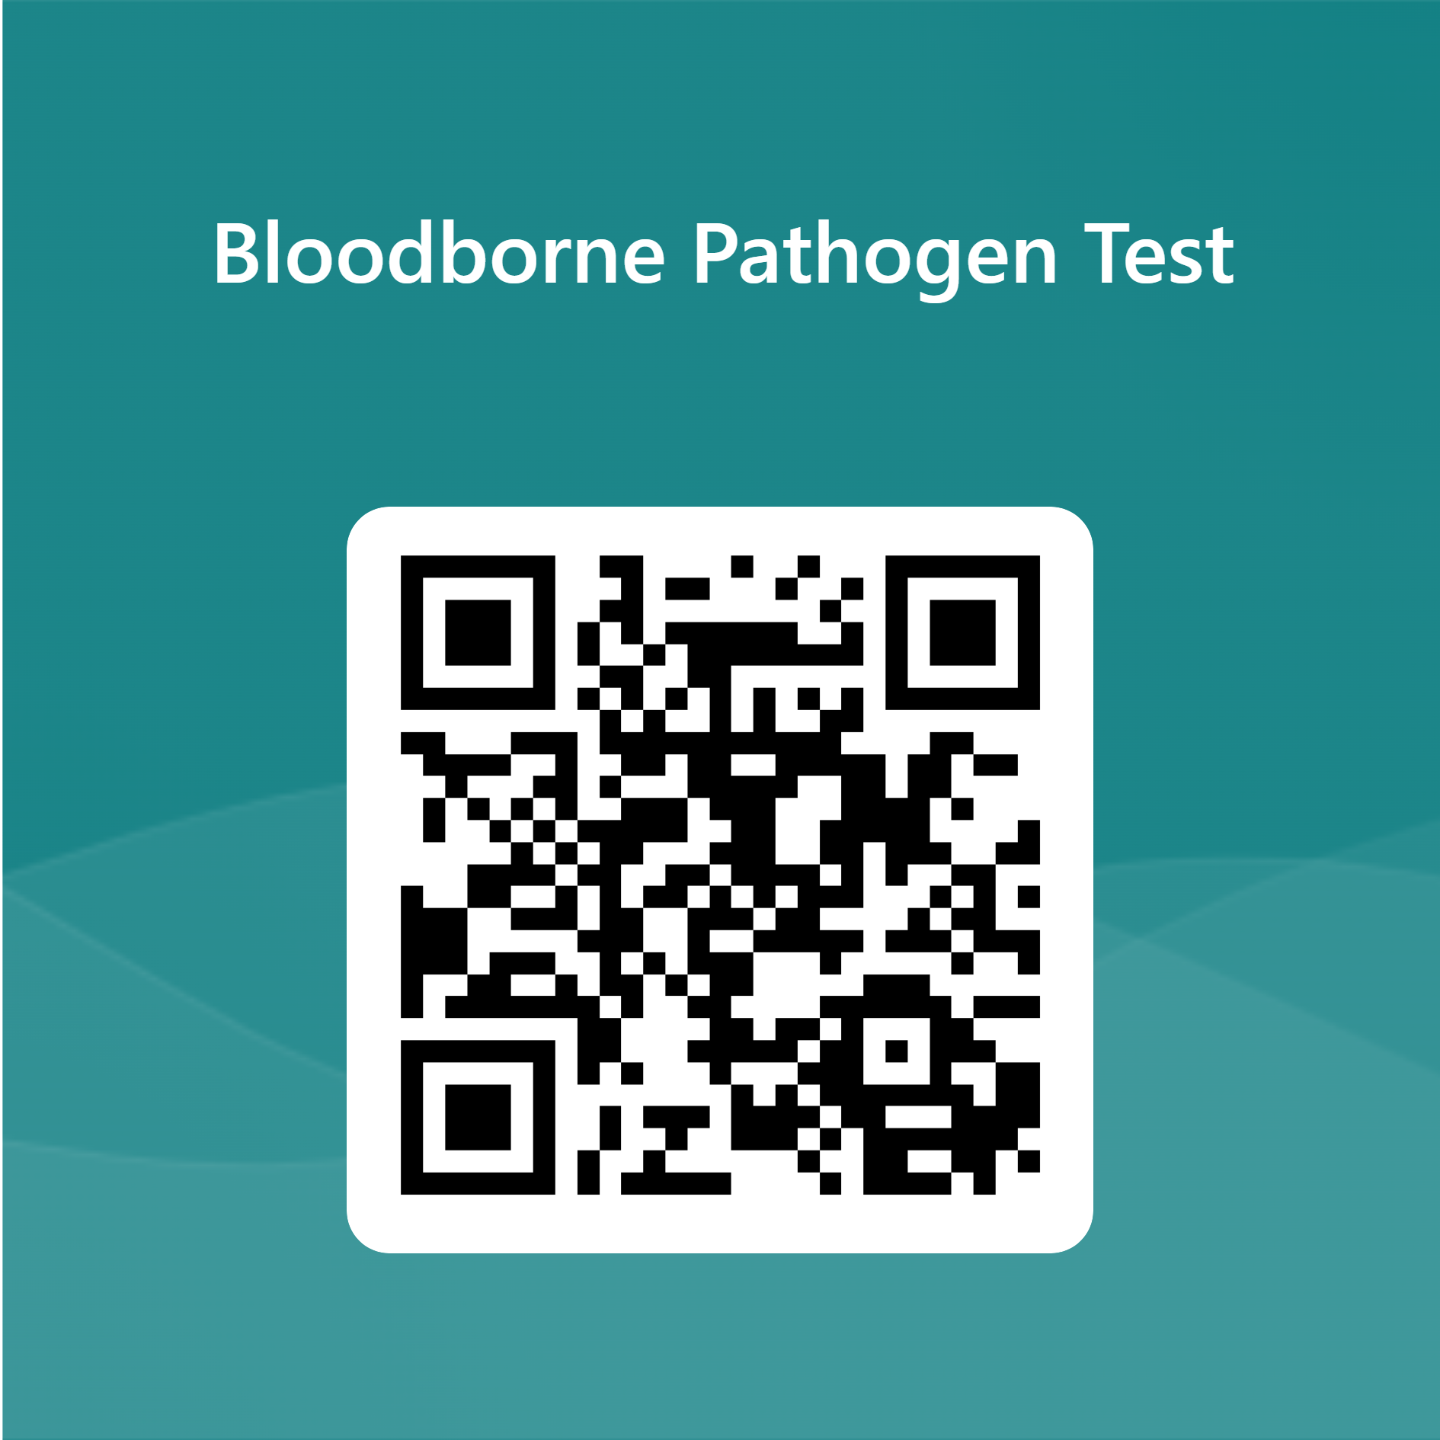
Continue to Test
Link
https://forms.office.com/r/NNMqkAgTJZ

